Slide 1
CLASSIFYING SIMILAR, BUT DISTINCT DEPRESSION AND Anxiety POSTS
Subreddit Classification by NICK VEGA
Notes:
Image source:
https://money.cnn.com/magazines/moneymag/bplive/2010/snapshots/PL1901855.html

Slide 2
Data Science Process
Define the problem.
Obtain the data.
Explore the data.
Model the data.
Evaluate the model.
Answer the problem.

Slide 3
unique Conditions that commonly occur Together, Symptoms overlap, But Treatments can be radically Different
Anxiety
Depression
Notes:
According to the Mayo Clinic, Depression and Anxiety are unique conditions that commonly occur together and have similar treatments
Anxiety may occur as a symptom of major depression and depression may be triggered by certain types of anxiety disorders
https://www.mayoclinic.org/diseases-conditions/depression/expert-answers/depression-and-anxiety/faq-20057989

Slide 4
Problem
Can we properly categorize posts about Depression and Anxiety?
Given that there is might be significant overlap between the two?

Slide 5
Problems with classifying these posts
There is a form of self selection with these posts. Based on their own experience, authors are posting descriptions based on where they feel it is appropriate
The most important words for each subreddit are similar…
…and there may be some overlap in posts.
CAN WE PROPERLY CLASSIFY THESE????

Slide 6
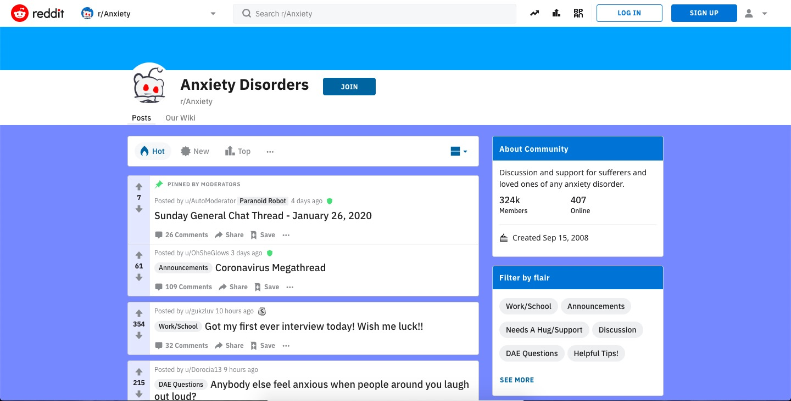
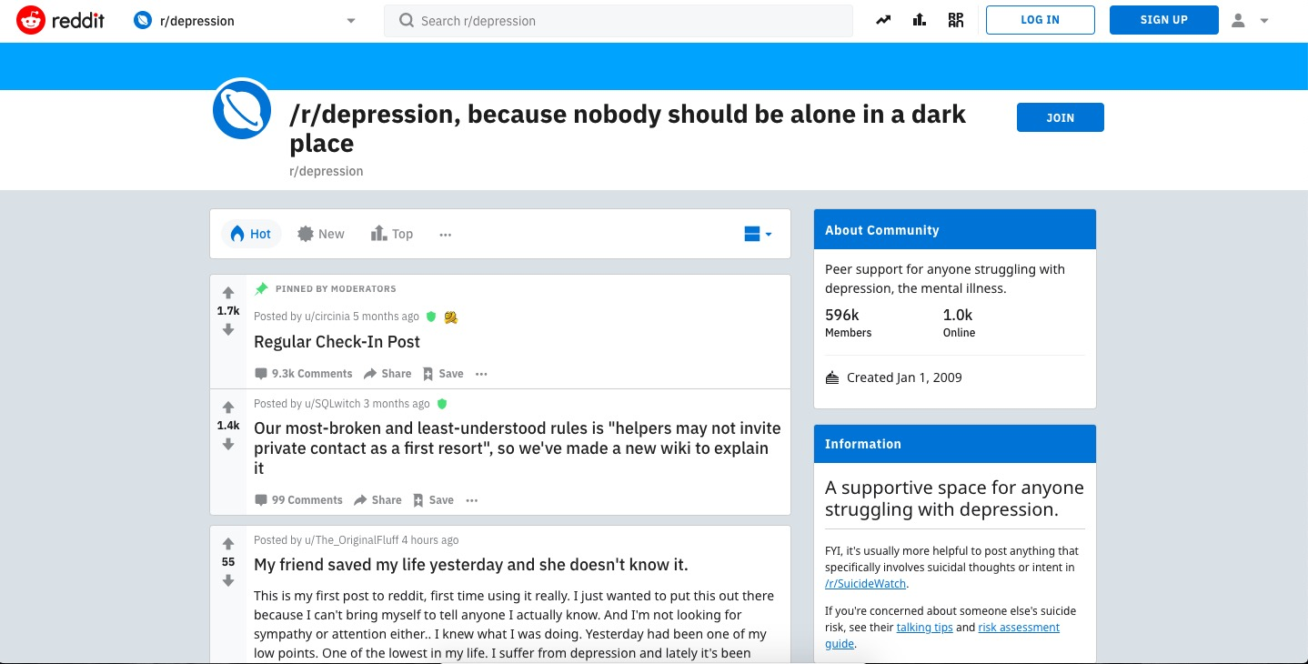
Acquiring THE DATA
Used PushShift API to obtain data from the two desired subreddits
Max size per pull is 500 posts
Performed 4 pulls for each subreddit to obtain 4,000 posts total before cleaning
Varied desired time frame on API (before/after parameters) to obtain range of posts

Slide 7
Data Cleaning and EDa
187 posts (of 4000) included the text ‘[removed]’ or ‘[deleted]’ in place of a typical post
Removed these posts as part of the data science process

Slide 8
MOST COMMON WORDS – Depression and Anxiety Posts
Notes:
Depression (Left) and Anxiety (Right)

Slide 9
Most frequent words in model - Lots of overlap
Notes:
“Anxiety” is a frequent term in both sub-reddits
Individuals who exhibit anxiety or depression tend to speak (and write?) using filler words—e.g., “just” “like” “really” “think”

Slide 10
Modeling
Constructed Four Primary Models
Applied a Word Lemmatizer and used Logistic Regression model to classify posts with Grid Search
Used Logistic Regression model WITHOUT Lemmatization to classify posts with Grid Search
Best performing
Applied TFIDFVectorizer and used a Naïve Gaussian Bayes Model
Poorest Performing
Bagging Classifier with CountVectorized Features
Best performance on training data, but exhibits large amount of overfit

Slide 11
Best Performing Logistic Regression Model
Accuracy and Smallest amount of overfit :
Training Data: 95.4%
Testing Data: 85.3%

Slide 12
Logistic Regression Model Extremely Valuable to identify words most important to an accurate Classification

Slide 13
Misclassification Example – Logistic Regression
Model Predicted Anxiety when True Classification was Depression:
'relationship with my parents, friendships, whenever I date someone, it’s all toxic. Im shy (mostly from anxiety), have low self-esteem, scared of change, scared of standing up for myself, etc etc. it sucks'

Slide 14
Bagging Model – Predicted Anxiety True Depression (emphasis Added)
"I'm 26 with ocd, severe health anxiety, depression and suicidal ideation. I dropped out of college when I was 19 and haven't been able to hold down a job. I think about my health and various diseases all day every day. I've seen psychiatrists and psychologists and CBT has done nothing. My medication has done nothing...I've tried dozens upon dozens of combinations. I also have a very mild cognitive disability and an officially tested IQ of 80. I cant drive due to severe anxiety and I've never had a girlfriend. I had sex only one time in my life when I was 20. I'm fortunate enough to at least have qualified for SSI. I'd be homeless struggling with these issues without it and being able to live with my dad. I attempted suicide at 19 and I'm starting to think about it again. I could never do that to my mom or dad though and I'm in so much pain. I dont have enough money to move to a city to try and find a job there and use public transit but it's an option I'd have to discuss with my mother and father. I really would like to start a business but I'm worried I'm not intelligent enough with my cognitive impairment. I'm at a loss of what I should do. I'm so fucking depressed, lonely, and scared. I'm scared of hell I'm scared of everything. I'm scared to be alive and I'm petrified of death. I just want to go to sleep."

Slide 15
Misclassification Causes
Overlapping categories
Overlapping language in posts
Self-diagnosis and self-selection into specific categories
”I feel ’X’ so I will post in X

Slide 16
Conclusion
Positively surprised by model performance
Potentially valuable tool that can be used to assist health professionals in diagnostic assessments
In extreme situations, websites such as Reddit can employ NLP techniques evaluated to push intervention banners
Raises Ethical and Confidentiality Issues
Some users appear to be treating these subreddits as an anonymous online journal.
Despite good intentions, is ethical to train a model to read posts?
Anonymization vs. confidential treatment in underlying data

